Slide 1
The Molecular basis of Inheritance

Slide 2
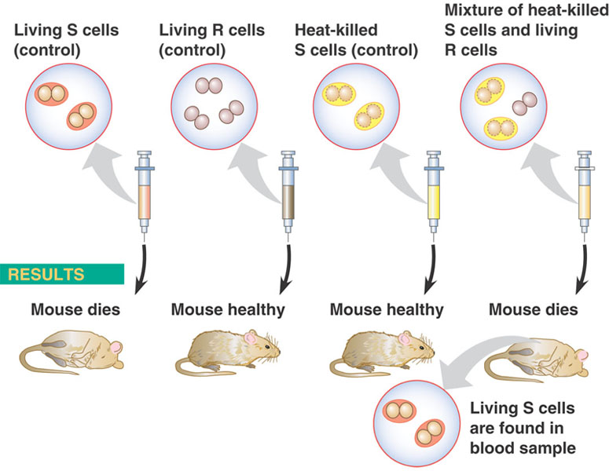

Slide 3
Griffith called the phenomenon transformation
  Now defined as a change in genotype and phenotype due to the assimilation of external DNA by a cell

Slide 4
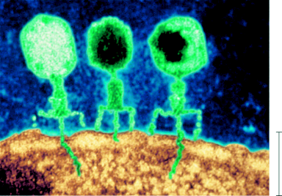
Bacteriophages
Phage
head
Tail
Tail fiber
DNA
100 nm
Bacterial
cell
Figure 16.3

Slide 5
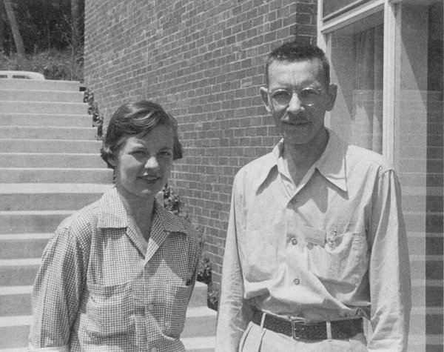
The Hershey-Chase Experiment
The Hershey-Chase Experiment
    Alfred Hershey and Martha Chase studied viruses—nonliving particles smaller than a cell that can infect living organisms.
Copyright Pearson Prentice Hall

Slide 6
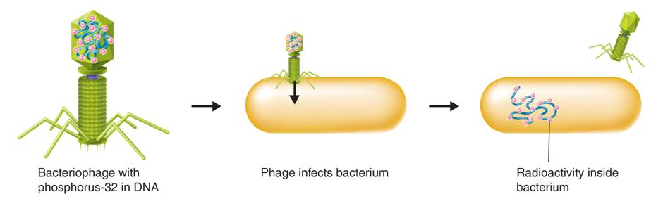
The Hershey-Chase Experiment
Hershey and Chase studied viruses that infect bacteria, or bacteriophages. They performed 2 experiments.
  Experiment 1: They tagged viral DNA with radioactive Phosphurus.
Copyright Pearson Prentice Hall

Slide 7
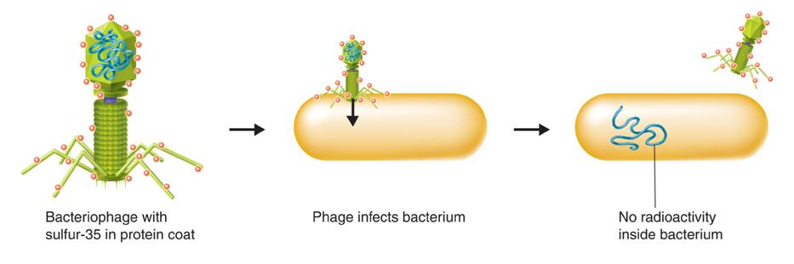
The Hershey-Chase Experiment
Hershey and Chase studied viruses that infect bacteria, or bacteriophages. They performed 2 experiments.
  Experiment 2: They tagged viral proteins with radioactive Sulphur.
Copyright Pearson Prentice Hall

Slide 8
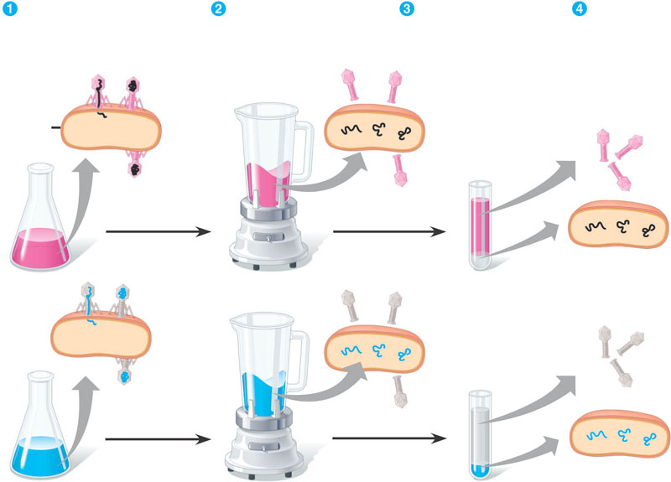

Slide 9
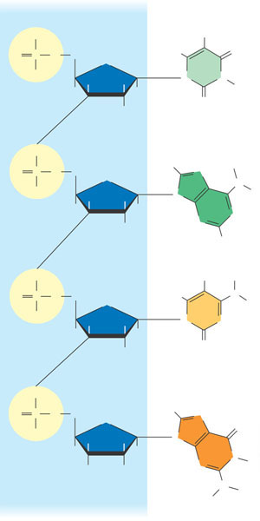
Additional Evidence That DNA Is the Genetic Material
Sugar-phosphate
backbone
Nitrogenous
bases
O–
5 end
CH₃
5
H
O
O
P
O
CH₂
O
O–
4
H
1
N
N
H
H
H
H
3
2
O
H
Thymine (T)
O
H
H
O
P
O
CH₂
O
N
O–
H
H
N
N
H
H
H
N
N
H
H
Adenine (A)
O
H
H
O
P
O
CH₂
O
H
N
H
O–
H
H
N
N
H
H
O
H
Cytosine (C)
O
5
O
P
O
CH₂
O
H
N
O–
4
1
O
Phosphate
H
H
N
H
H
N
3
2
N
H
DNA nucleotide
OH
H
Sugar (deoxyribose)
3 end
H
N
H
Figure 16.5
Guanine (G)

Slide 10
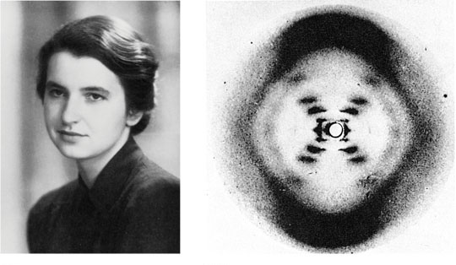
Rosalind Franklin
(a) Rosalind Franklin
(b)
Franklin’s X-ray diffraction
Photograph of DNA
Figure 16.6 a, b

Slide 11
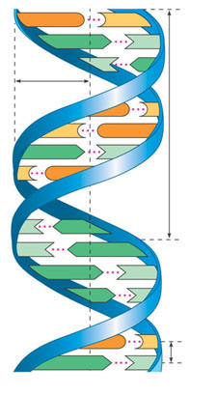
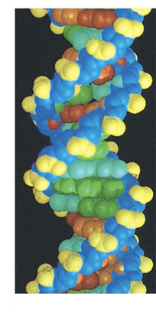
G
C
A
T
T
A
1 nm
G
C
C
G
3.4 nm
A
T
C
G
T
A
T
A
A
T
A
T
G
C
0.34 nm
A
T
Figure 16.7a, c
(a) Key features of DNA structure
(c) Space-filling model

Slide 12
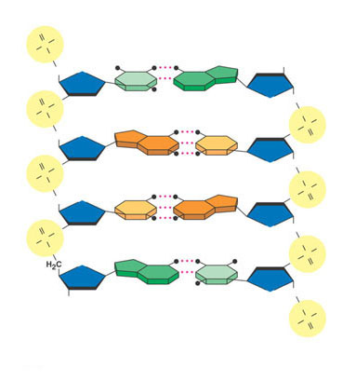
5 end
O
OH
P
Hydrogen bond
–O
O
3 end
OH
O
T
A
O
O
O
CH₂
–O
P
O
O
O–
O
P
H₂C
O
G
C
O
O
O
O
CH₂
–O
P
O
O
O–
O
P
H₂C
O
C
G
O
O
O
O
CH₂
P
O
–O
O
O–
O
P
H₂C
O
A
T
O
O
CH₂
OH
O
3 end
O–
O
P
(b) Partial chemical structure
O
Figure 16.7b
5 end

Slide 13
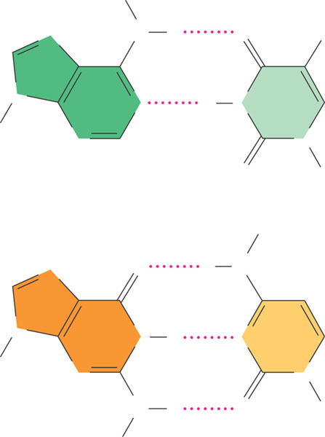
H
N
N
H
O
CH₃
N
N
H
N
Sugar
N
N
O
Sugar
Adenine (A)
Thymine (T)
H
N
O
H
N
N
N
H
N
Sugar
N
N
N
H
O
Sugar
H
Figure 16.8
Guanine (G)
Cytosine (C)

Slide 14
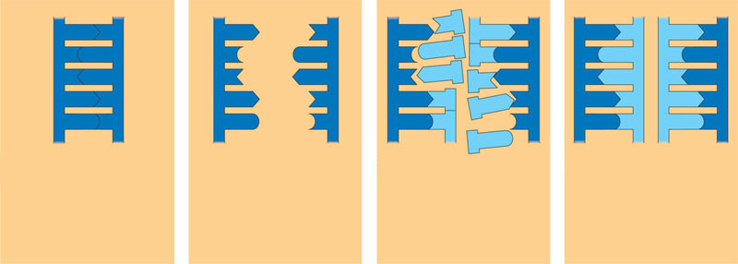
In DNA replication
  The parent molecule unwinds, and two new daughter strands are built based on base-pairing rules
A
T
A
T
A
T
A
T
A
T
A
T
C
G
C
G
C
G
C
G
C
G
C
G
T
A
T
A
T
A
T
A
T
A
T
A
A
T
A
T
A
T
A
T
A
T
A
T
G
C
G
C
G
C
C
G
C
G
C
G
(a) The parent molecule has two
complementary strands of DNA.
Each base is paired by hydrogen
bonding with its specific partner,
A with T and G with C.
(b) The first step in replication is
separation of the two DNA
strands.
(c) Each parental strand now
serves as a template that
determines the order of
nucleotides along a new,
complementary strand.
(d) The nucleotides are connected
to form the sugar-phosphate
backbones of the new strands.
Each “daughter” DNA
molecule consists of one parental
strand and one new strand.
Figure 16.9 a–d

Slide 15
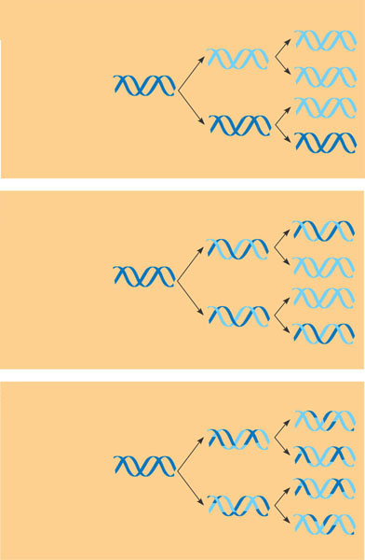
DNA replication is semiconservative
First
replication
Second
replication
Parent cell
Conservative
model. The two
parental strands
reassociate
after acting as
templates for
new strands,
thus restoring
the parental
double helix.
(a)
Semiconservative
model. The two
strands of the
parental molecule
separate,
and each functions
as a template
for synthesis of
a new, comple-
mentary strand.
(b)
Dispersive
model. Each
strand of both
daughter mol-
ecules contains
a mixture of
old and newly
synthesized
DNA.
(c)
Figure 16.10 a–c

Slide 16

Meselson-Stahl Experiment
E. coli were grown for several generations in a medium with ¹⁵N.
The DNA of the resuling cells had a higher density (was heavier).
E. coli cells with only ¹⁵N in their DNA were put back into a ¹⁴N medium and were allowed to divide only once.
DNA was then extracted from a cell and was compared to DNA from ¹⁴N DNA and ¹⁵N DNA.
It was found to have exactly an intermediate density. This supported the idea of semiconservative replication.
The DNA was intermediate in density because it had an all ¹⁵N DNA strand and an all ¹⁴N DNA strand. The all ¹⁵N strand was one of the original strands in the original cell. The all ¹⁴N strand was a newly synthesized strand.

Slide 17
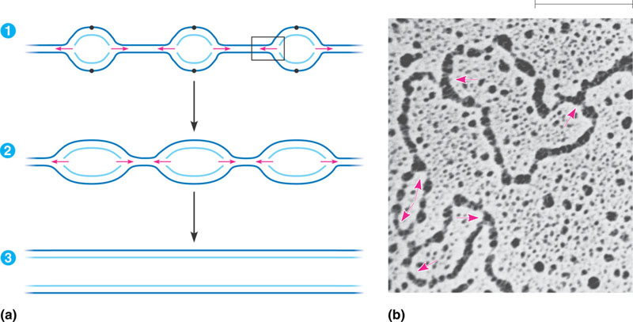

Slide 18
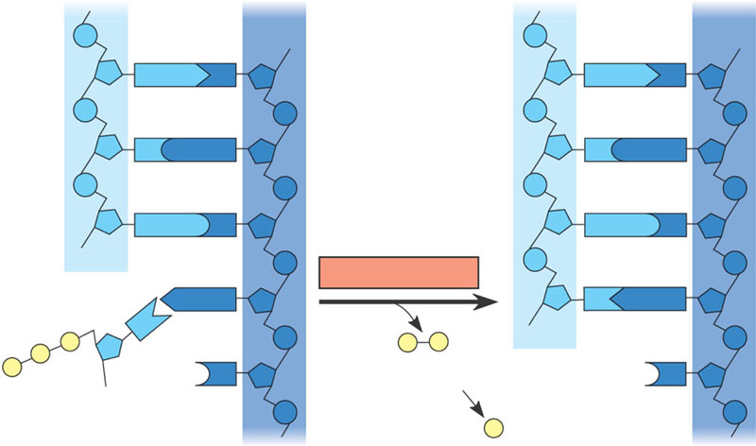
Elongating a New DNA Strand
New strand
Template strand
5 end
3 end
5 end
3 end
Sugar
A
T
A
T
Phosphate
Base
C
G
C
G
G
C
G
C
A
T
A
T
OH
P
P
P
P
Pyrophosphate
3 end
P
C
C
OH
2 P
Nucleoside
triphosphate
Figure 16.13
5 end
5 end

Slide 19
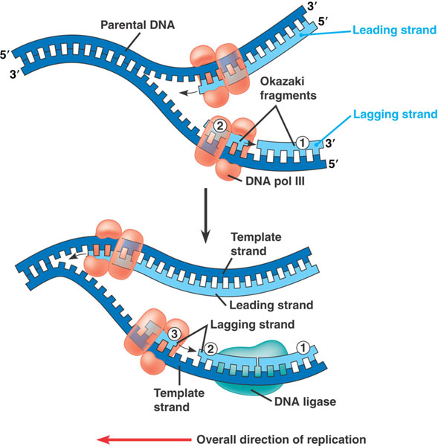

Slide 20
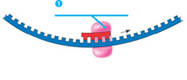

Slide 21
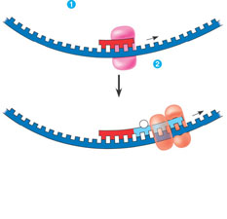

Slide 22
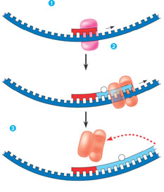

Slide 23
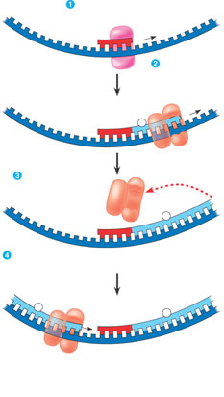

Slide 24
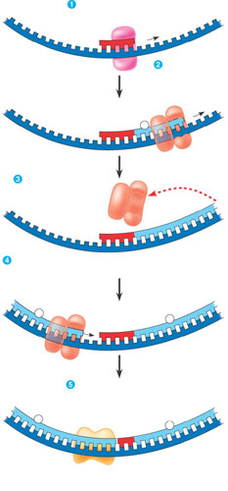

Slide 25
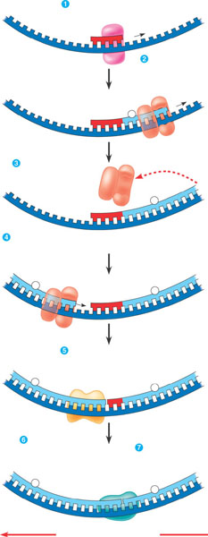

Slide 26
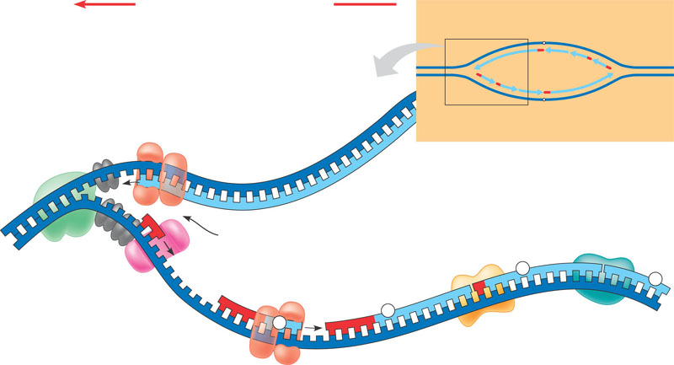
Overall direction of replication
Leading
strand
Lagging
strand
Helicase unwinds the
parental double helix.
Origin of replication
1
2
Molecules of single-
strand binding protein
stabilize the unwound
template strands.
3
The leading strand is
synthesized continuously in the
5 3 direction by DNA pol III.
Lagging
strand
Leading
strand
OVERVIEW
DNA pol III
Leading
strand
5
Replication fork
DNA ligase
3
DNA pol I
Parental DNA
Primase
2
Primer
DNA pol III
Lagging
strand
1
3
4
Primase begins synthesis
of RNA primer for fifth
Okazaki fragment.
3
5
4
5
6
7
DNA pol III is completing synthesis of
the fourth fragment, when it reaches the
RNA primer on the third fragment, it will
dissociate, move to the replication fork,
and add DNA nucleotides to the 3 end
of the fifth fragment primer.
DNA pol I removes the primer from the 5 end
of the second fragment, replacing it with DNA
nucleotides that it adds one by one to the 3 end
of the third fragment. The replacement of the
last RNA nucleotide with DNA leaves the sugar-
phosphate backbone with a free 3 end.
DNA ligase bonds
the 3 end of the
second fragment to
the 5 end of the first
fragment.
Figure 16.16

Slide 27
Proofreading and Repairing DNA
DNA polymerases proofread newly made DNA
  Replacing any incorrect nucleotides
In mismatch repair of DNA
  Repair enzymes correct errors in base pairing

Slide 28
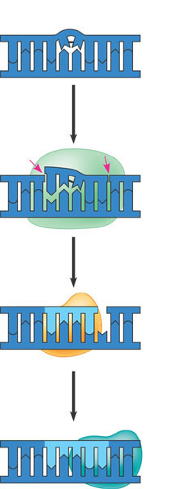
nucleotide excision repair
2
3
DNA
ligase
4
Figure 16.17

Slide 29
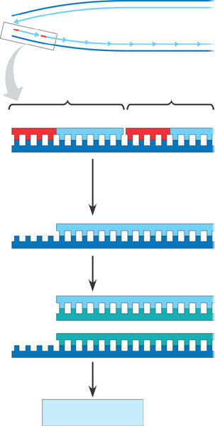
Replicating the Ends of DNA Molecules
The ends of eukaryotic chromosomal DNA
  Get shorter with each round of replication
End of parental
DNA strands
5
Leading strand
Lagging strand
3
Last fragment
Previous fragment
RNA primer
Lagging strand
5
3
Primer removed but
cannot be replaced
with DNA because
no 3 end available
for DNA polymerase
Removal of primers and
replacement with DNA
where a 3 end is available
5
3
Second round
of replication
5
New leading strand
3
New lagging strand 5
3
Further rounds
of replication
Figure 16.18
Shorter and shorter
daughter molecules

Slide 30
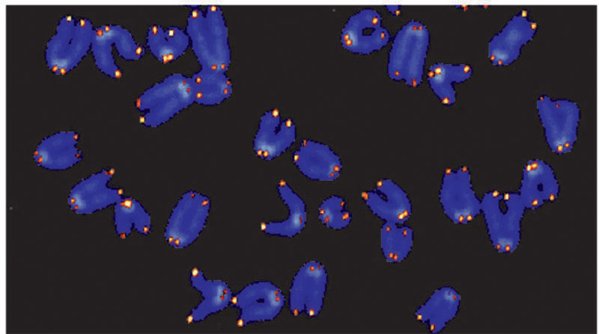
Eukaryotic chromosomal DNA molecules
  Have at their ends nucleotide sequences, called telomeres, that postpone the erosion of genes near the ends of DNA molecules
Figure 16.19
1 µm

Slide 31
If the chromosomes of germ cells became shorter in every cell cycle
  Essential genes would eventually be missing from the gametes they produce
An enzyme called telomerase
  Catalyzes the lengthening of telomeres in germ cells

